Slide 1
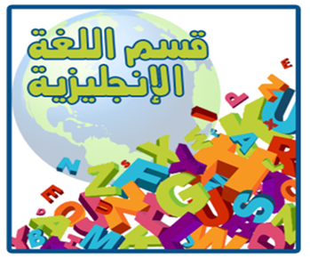
English phonetics Course LECTURE 6 Stress
INSTRUCTOR: Prof. Hesham Hasan

Slide 2
Stress definition
Stress is the relative loudness or force with which we pronounce the different syllables of a word . It varies from syllable to syllable. For example , in the word record ( noun) and the word record (verb) we notice that in the noun form the first syllable is pronounced with more force than the second , whereas in the verb form the second is more prominent than the first. We say, then, that in the noun form , the first syllable receives a high stress and the second receives a weak stress. In the verb form, it is the second syllable that receives the high stress and the first the weak stress.

Slide 3
EXAMPLES

Slide 4
WORDS WITH THE HIGH STRESS ON THE FIRST SYLLABLE
THOUSAND-
NEIGHBOUR-
CHILDHOOD-
DOCTRINE-
DIPHTHONG
CROCODILE-
CATALOGUE-
UNIFORM-
HUNDRED-
ENGLISH-
HANDSOME-

Slide 5
Words with the high stress on the second syllable
Sincere
Humane
Severe
Courageous
Exotic
Authentic
Historical
Romanticism
Condition
Hotel
Romance
police

Slide 6
WORDS WITH THE HIGH STRESS ON THE THIRD SYLLABLE
LEMONADE
ALPHAOETIC
UNIFORMITY
INTRODUCTION
DISCONTINOUS
INTERMEDIATE
ECONOMICAL
SUPERNATURAL
DISINFECT
GUARANTEE

